Slide 1




UX AUDIT REPORT
JANUARY 2024
High level expert review
Heuristic evaluation & user interviews

Slide 2
1. INTRODUCTION - What we did
Executive Summary
Goals and objectives
2. METHODOLOGY- Process and Methods
Nielsen's Heuristic Evaluation
Ben Shneiderman’s 'Eight Golden Rules of Interface Design
Arnold Lund's 34 Usability Maxims
Norman's Theory of Action
Web3 Design Audit Checklist Based on Web3 Design Principles by Beltran
3. FINDINGS - What we tested on
Recommendations
4. INSIGHTS AND NEXT STEPS - What we tested on
Recommendations
In this report

Slide 3

ALCHEMIX FINANCE
UX AUDIT REPORT
INTRODUCTION

Slide 4
EXECUTIVE SUMMARY
In this comprehensive UX audit, we conducted an expert review of Alchemix Finance user experience based on Web3 usability guidelines and expert review checkpoints. The aim was to assess the platform's alignment with industry best practices, ensuring a seamless and user-centric experience for all users interacting with Web3 technologies.
Our review focused on evaluating critical aspects such as platform accessibility, navigation, search functionality, user education, error handling, and the integration of Web3 wallet functionalities. Through a meticulous assessment, we identified several areas that require immediate attention to enhance the overall user experience.

Slide 5
247 WEB USABILITY GUIDELINES
This review focused on evaluating critical aspects such as platform accessibility, navigation, search functionality, user education, error handling, etc. Through a meticulous assessment, we identified several areas that require immediate attention to enhance the overall user experience.
UX PRINCIPLES | COMPLIES | DOESN’T COMPLY | NOT APPLICABLE | COMPLIANCE RATE
Home Page | 13 Criteria | None | None | 100%
Task orientation | 18 Criteria | 3 Criteria | 3 Criteria | 86%
Navigation and IA | 19 Criteria | None | None | 100%
Forms and data entry: | 11 Criteria | None | 5 Criteria | 100%
Trust and credibility | 8 Criteria | None | None | 100%

Slide 6
UX PRINCIPLES | COMPLIES | DOESN’T COMPLY | NOT APPLICABLE | COMPLIANCE RATE
Writing and content quality | 18 Criteria | None | 1 Criteria | 100%
Page layout and visual design: | 34 Criteria | None | None | 100%
Search usability | None | None | 16 Criteria | 0%
Help, feedback and error tolerance | 19 Criteria | 4 Criteria | 2 Criteria | 82%
Total | 140 Criteria | 7 Criteria | 27 Criteria | 95%

Slide 7
REVIEW BASED ON WEB3 UX PRINCIPLES
This review focused on evaluating critical aspects involved in the integration of Web3 wallet functionalities.
UX PRINCIPLES | COMPLIES | DOESN’T COMPLY | NOT APPLICABLE | COMPLIANCE RATE
Transparency of Data provenance | 2 Criteria | 2 Criteria | None | 50%
Transparency of Transactions | 4 Criteria | 3 Criteria | 1 Criteria | 57%
Transparency of Smart Contract | 1 Criteria | 1 Criteria | 1 Criteria | 50%
Transparent User interaction History | None | 3 Criteria | None | 0%
Transparency of Code | 4 Criteria | 3 Criteria | None | 57%

Slide 8
UX PRINCIPLES | COMPLIES | DOESN’T COMPLY | NOT APPLICABLE | COMPLIANCE RATE
Human Readable Hashes Format | 1 Criteria | 2 Criteria | 1 Criteria | 33%
Time/Wait Management | 1 Criteria | 1 Criteria | None | 50%
Permanent Newbie Mode | 1 Criteria | 2 Criteria | None | 33%
Gas Price and Transaction Reversal | 2 Criteria | 1 Criteria | None | 66%
Sense of Community | 4 Criteria | None | None | 100%
Total | 20 Criteria | 18 Criteria | 3 Criteria | 52%

Slide 9
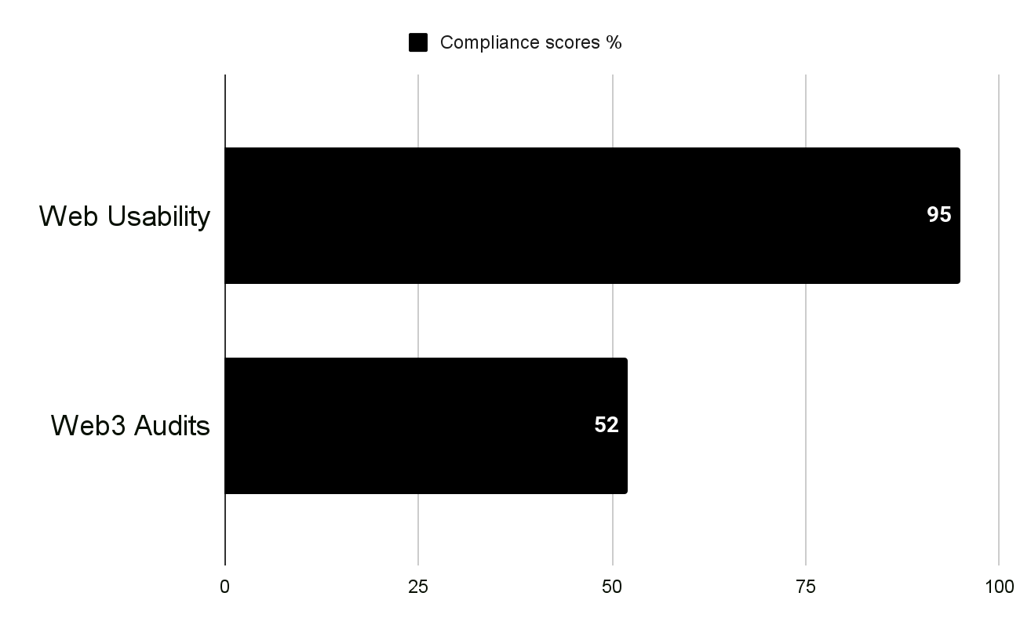
USABILITY STATS
Overall Compliance percentage
Usability Score
GOOD
86.48%
Users should be able to use this site or system with relative ease and should be able to complete the vast majority of important tasks.
Overall Compliance
Overall non compliance
160/185
25/185

Slide 10
PRODUCT OVERVIEW
Alchemix Finance is a future-yield-backed synthetic asset protocol and community DAO. The protocol gives you advances on various yield farming strategies via a synthetic token. The token represents a fungible claim on the underlying collateral in the Alchemix protocol, where the claim has to be made by a depositor of that collateral.
CONTEXT OF THE AUDIT
This study involved collecting a rich research database consisting of detailed observations and findings based on Nielsen's Heuristic Evaluation, Design Arnold Lund's 34 Usability Maxims, and Web3 Design Audit Checklist Based on Web3 Design Principles by Beltran
These valuable resources complement and support the findings presented in this report.

Slide 11
ALCHEMIX FINANCE
UX AUDIT REPORT
METHODOLOGY

Slide 12
METHODOLOGY
This report summarizes the findings of a comprehensive UX audit conducted on Alchemix Finance platform.
The audit utilized a combination of renowned UX methodologies, including Nielsen's Heuristic Evaluation, Ben Shneiderman’s 'Eight Golden Rules of Interface Design, Arnold Lund's 34 Usability Maxims, Norman's Theory of Action, and the Web3 Design Audit Checklist Based on Web3 Design Principles by Beltran.
The purpose of the audit was to assess the user experience and identify areas for improvement to enhance usability and overall satisfaction

Slide 13
SEVERITY SCALE
Critical
Severely impairs the use of the product and cannot be overcome by users. It is necessary to fix this before releasing the product..
Serious
Occurs frequently and persistently, or users may not be able to resolve the issue or may not be aware of it. It's important to fix this, so give it a high priority..
Medium
May occur more often or be harder to overcome. Fixing this should be a low release priority.
Low
Can be easily overcome by the user or occurs very rarely. The release does not require repair unless additional time is available.

Slide 14
ALCHEMIX FINANCE
UX AUDIT REPORT
FINDINGS

Slide 15
BUSINESS GOALS
Collateral-backed Loans: Alchemix allows users to deposit collateral in the form of crypto assets and mint a synthetic stablecoin called alUSD. This stablecoin represents a loan value that users can use without having to sell their deposited assets.
Self-repaying Loans: One of the unique features of Alchemix is the concept of self-repaying loans. Instead of users having to actively repay their loans, the system is designed to utilize the yield generated by the deposited collateral to automatically repay the loan over time.
Yield Optimization: Alchemix aims to provide users with a way to optimize their yield farming strategies. By leveraging assets through the minting of alUSD, users can participate in other DeFi protocols or liquidity pools to maximize their returns.
Asset Exposure and Price Appreciation: Users can benefit from both the potential price appreciation of their deposited assets and the yield generated by those assets. Alchemix allows users to maintain exposure to their crypto holdings while accessing liquidity through the minting of synthetic stablecoins.
Innovation in DeFi: Alchemix represents an innovative approach to decentralized finance, introducing a novel concept for collateralized loans and repayment mechanisms. The platform contributes to the ongoing evolution of financial instruments within the DeFi ecosystem.

Slide 16
CUSTOMER GOALS
Stablecoin Generation: Users aim to generate a synthetic stablecoin (alUSD) by depositing collateral into the Alchemix system. This stablecoin allows them to access liquidity without immediately selling their assets.
Yield Farming Optimization: Users might leverage Alchemix to optimize their yield farming strategies. By minting alUSD against their collateral, users can participate in other DeFi protocols or liquidity pools to maximize their overall yield.
Capital Efficiency: Alchemix users may be seeking a way to maintain exposure to the potential price appreciation of their assets while utilizing them to generate additional value through yield farming or other DeFi activities.
Risk Management: Users may be attracted to Alchemix as a means of managing risk. The system's design, with self-repaying loans using future yield, aims to reduce the risk of liquidation and provide a more stable experience for users.
Innovation and Exploration: Some users may be drawn to Alchemix for its innovative approach to decentralized finance. The platform introduces unique concepts, and users may be interested in exploring and participating in novel financial instruments.

Slide 17
FINDINGS
Heuristic Used
Select the appropriate heuristics principle that matches the usability issue you’ve identified.
Severity
From the severity scale, select the appropriate rating for the usability issue you’ve identified.
Issue and Recommendation
Describe the usability issue and spell out your recommendations for UX improvements.

Slide 18
ALCHEMIX FINANCE
UX AUDIT REPORT
TASK ORIENTATION AND SITE FUNCTIONALITY
People go to web sites to achieve particular goals, not to look around and admire the design. This means web pages needs to support customer tasks. A site is task oriented when it supports users in the effective and efficient completion of their tasks.

Slide 19
Issue (MEDIUM)
Recommendations
The platform does not display all the steps that need to be completed in a task. Users are left without a comprehensive overview of the entire workflow, making it difficult for them to anticipate the scope of the task and plan their actions accordingly.
Display all the steps involved in a task, providing users with a complete overview of the workflow. Present the steps in a logical order, ensuring they are easily scannable and comprehensible. This helps users understand the entire process and the sequence of actions required to complete the task.

Slide 20
ALCHEMIX FINANCE
UX AUDIT REPORT
HELP, FEEDBACK AND ERROR TOLERANCE
These guidelines help assess if the site helps prevent customers from making errors. A site is error-tolerant if, despite evident errors in input, the intended result may be achieved with either no or minimal corrective action by the customer.

Slide 21
Issue (MEDIUM)
Recommendations
The platform lacks a crucial user confirmation step before executing potentially 'dangerous' actions, such as deleting important elements. This deficiency introduces a risk of unintended and irreversible user actions, potentially leading to data loss or other adverse outcomes.
The platform does not offer informative prompts or messages that educate users about its features, functionalities, or hidden capabilities. Users may miss out on important functionalities, shortcuts, or best practices that could enhance their experience and improve their efficiency.
Implementing explicit confirmation prompts, requiring users to confirm their intent before proceeding with actions that carry significant consequences. This redesign aims to provide users with an additional layer of protection, ensuring deliberate and informed decisions when engaging in actions with potential ramifications.
Introduce informative prompts strategically placed throughout the platform to provide helpful tips, suggestions, or feature highlights. These prompts should be context-sensitive and appear at relevant moments to guide users, showcase hidden functionalities, or share best practices.

Slide 22
Issue (MEDIUM)
Recommendations
The site falls short in its ability to effectively prevent users from making errors, potentially leading to unintended mistakes and a suboptimal user experience.
The platform does not prompt users before automatically correcting their erroneous input. Users may not be aware of mistakes in their input, and the platform's failure to provide suggestions or alternatives can result in inaccurate or undesired outcomes.
Implementing proactive error prevention measures, such as intuitive user guidance, clear instructions, and interactive feedback. By enhancing the platform's error prevention mechanisms, this redesign aims to empower users with a more user-friendly and error-resistant interface, reducing the likelihood of unintended errors and fostering a smoother overall user experience
Introduce error correction prompts that appear when the user's input is potentially incorrect or misspelled. These prompts should provide suggestions or alternatives based on common errors or closely related terms, allowing users to review and correct their input if needed

Slide 23
ALCHEMIX FINANCE
UX AUDIT REPORT
TRANSPARENCY OF DATA PROVENANCE
Does the application clearly indicate which data comes from the blockchain and which does not?
Are the addresses of the contracts clearly stated?
Are all blockchain data linked to independent blockchain explorers?
Is it clear which data comes from oracles?

Slide 24
Issue (LOW)
Recommendations
Alchemix Finance does not clearly indicate which data originates from the blockchain and which data does not.
Platform does not provide clear indications regarding the origin of data from oracles.
Improve Data Indication: Clearly differentiate between data originating from the blockchain and data from other sources.
Enhance Oracle Data Transparency: Clearly disclose the sources of data obtained from oracles

Slide 25
ALCHEMIX FINANCE
UX AUDIT REPORT
TRANSPARENCY OF TRANSACTIONS
Are irreversible actions clearly indicated?
Are actions involving money or value clearly indicated?
Are actions that could potentially lead to user identification clearly indicated?
Are actions that generate new contracts in the user's name clearly indicated?
Does the application clarify and confirm the new future state in advance?
Is the data being used for a transaction shown in a human-readable format?
Are suggested values for gas price clarified and how to overwrite the transaction?
Is transaction wait time managed effectively

Slide 26
Issue (LOW)
Recommendations
The platform does not provide clear indications for actions that are irreversible. Users are not adequately informed about the irreversible nature of certain actions, which can result in accidental or unintended actions that cannot be undone or reversed.
Alchemix Finance fails to clearly indicate actions that could potentially lead to user identification. This lack of clarity raises significant concerns regarding user privacy and data protection.
The application lacks an effective mechanism to clarify and confirm the new future state in advance, leaving users without adequate information about the consequences of their actions. This deficiency introduces a risk of user confusion and unintended outcomes.
Visual Cues and Warnings: Implement visual cues and warning messages to clearly indicate irreversible actions. Use distinctive icons, colors, or prominent notifications to draw attention to these actions and provide explicit warnings about the consequences. Make sure the language used in the warnings is clear, concise, and easy to understand.
Implementing clear communication strategies, such as informative prompts, visual aids, or step-by-step guides, to ensure users are well-informed about the impending changes before proceeding. This redesign aims to enhance user understanding, mitigate uncertainties, and foster a more transparent and user-centric experience within the platform

Slide 27
ALCHEMIX FINANCE
UX AUDIT REPORT
TRANSPARENCY OF SMART CONTRACT EVENTS
Are all events, even those for developer purposes, clarified and made accessible to the end user?
Are interrupting messages shown only for information relevant to the current user?
Can users subscribe to, unsubscribe from, or temporarily mute certain events?

Slide 28
Issue (LOW)
Recommendations
The platform fails to provide clarity and accessibility for all events, including those intended for developer purposes, hindering the overall user experience. Users may be left uninformed about various system events, leading to confusion and potential frustration.
Implement a comprehensive event notification system, ensuring that relevant information is presented in a user-friendly manner. This redesign aims to enhance transparency and accessibility, keeping end-users informed about all events, including those essential for developers, and contributing to a more cohesive and user-centric experience on the platform.

Slide 29
ALCHEMIX FINANCE
UX AUDIT REPORT
TRANSPARENCY AND ACCESSIBILITY OF USER’S INTERACTION HISTORY
Does the application provide a history of all transactions from a given address?
Is it clear where the history is stored (local or server)?
Are tools provided to navigate, search, export, and delete the history cache?

Slide 30
Issue (MEDIUM)
Recommendations
This absence of transaction history significantly limits the user's ability to track and review their past activities, hindering transparency and user engagement.
The platform does not provide clear indications of where the user's history is stored, whether it is stored locally on the user's device or on the server. This lack of clarity can lead to user confusion and concerns regarding data privacy, accessibility, and potential data loss.
Alchemix does not provide users with the necessary tools to navigate, search, export, or delete the history cache. This lack of functionality restricts users from efficiently managing and leveraging their transaction history, impacting usability and user control.
Implement a dedicated section that provides users with a clear and complete transaction history for a given address. This feature will empower users to review and analyze their past activities, fostering transparency and accountability
Clearly communicate to users whether their history is stored locally on their device or on the server. This can be achieved by providing explanatory text or tooltips that detail the storage location and the implications associated with it, such as data synchronization or potential limitations.
Introduce user-friendly tools to navigate, search, export, and delete the history cache. These features will enable users to efficiently access and manipulate their transaction data, enhancing usability and user control.

Slide 31
ALCHEMIX FINANCE
UX AUDIT REPORT
TRANSPARENCY OF CODE
Is it clear which blockchain is being used?
Are the addresses of the Smart Contracts used in read/write operations clarified?
Is it clear which code is open source and where to find it?
Is it clear where code is being run (local vs remote server)?
Is the web3 provider / Blockchain node clarified?

Slide 32
Issue (LOW)
Recommendations
The platform does not clearly indicate whether the code is being run locally on the user's device or on a remote server.
The platform lacks clarity in indicating whether the Dapp is running on MainNet or TestNet, creating potential confusion for users. This oversight can lead to unintended actions or misunderstandings about the environment in which they are interacting.
Clearly communicate whether the code is executed locally or on a remote server, addressing concerns related to data privacy, security, and external dependencies.
Implement clear and prominent indicators, such as visual cues or labels, that unmistakably communicate whether the Dapp is operating on MainNet or TestNet. This redesign aims to enhance user awareness and confidence, ensuring users are well-informed about the network environment and can interact with the platform securely and purposefully

Slide 33
ALCHEMIX FINANCE
UX AUDIT REPORT
TIME/WAIT MANAGEMENT
Does the application clarify blockchain specific times and manage user’s wait in various phases?
Are liveness indicators shown during waiting time?

Slide 34
Issue (MEDIUM)
Recommendations
The application lacks effective clarification of blockchain-specific times and does not adequately manage user wait times during various phases, contributing to potential user frustration and uncertainty. Users may experience delays without understanding the underlying blockchain processes.
Implement clear notifications, progress indicators, and estimated wait times to keep users informed about the status of their transactions. This redesign aims to improve user expectations, reduce uncertainty, and create a more user-friendly experience by managing and communicating wait times effectively throughout different phases on the blockchain.

Slide 35
ALCHEMIX FINANCE
UX AUDIT REPORT
HUMAN READABLE HASHES FORMAT
Are compact versions of the hashes shown but always showing the initial and end parts?
Are users allowed to expand the full address/hash?
Can users easily copy it?
Is a custom human readable name or text associated with the addresses and hashes?

Slide 36
Issue (MEDIUM)
Recommendations
Inability to Expand Full Address/Hash: Users are not provided with a mechanism to expand the full details of addresses or hashes, restricting their ability to view the complete information associated with these identifiers.
Challenges in Copying: Users face difficulties in copying addresses or hashes easily. The absence of intuitive copy options may result in a cumbersome process, impacting user efficiency and convenience.
Expandable Address/Hash Details: Implement a user-friendly solution that allows users to expand the full details of addresses or hashes with a single click or tap. This can be achieved through an interactive tooltip, modal, or expandable section, providing users with comprehensive information.
Copy-to-Clipboard Functionality: Introduce an easily accessible "Copy" button or icon adjacent to addresses or hashes, enabling users to copy the information effortlessly. Additionally, consider incorporating a visual indicator or confirmation to assure users that the copy action has been successfully completed.

Slide 37
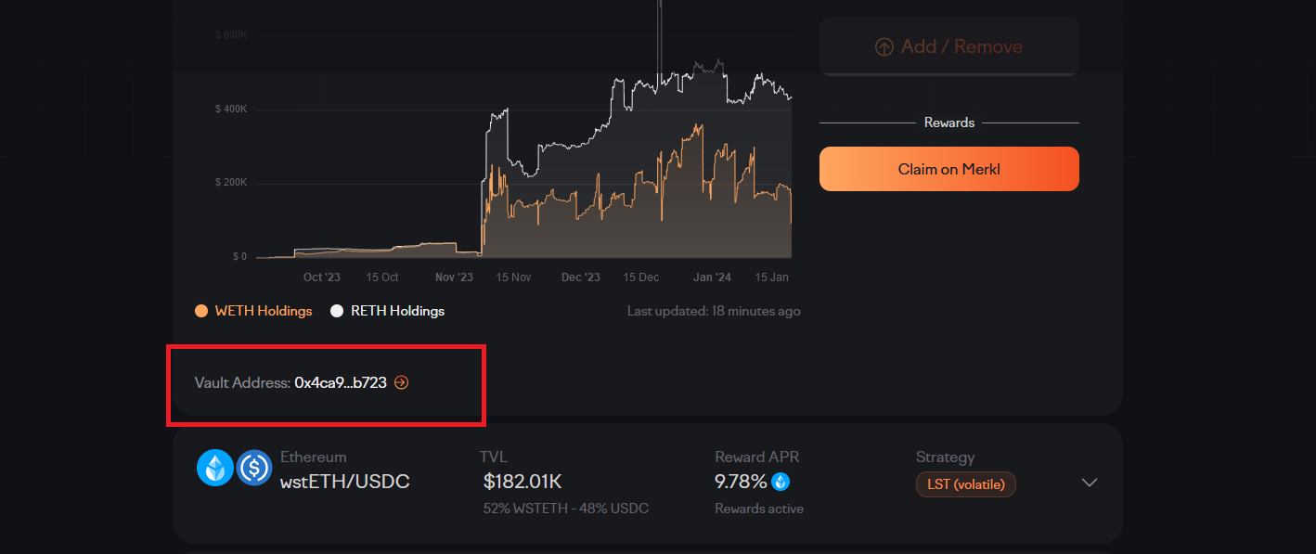
Users are not provided with a mechanism to expand the full details of addresses or hashes nor can they easily copy the address.

Slide 38
ALCHEMIX FINANCE
UX AUDIT REPORT
PERMANENT NEWBIE MODE
Is educational information woven into normal interaction?
Are there 2 or more levels of educational content: Blockchain basics and Dapp specific lingo?
Is the amount of new things and concepts that the user needs to learn minimized and increased progressively?

Slide 39
Issue (MEDIUM)
Recommendations
Lack of Educational Tiering: The platform does not offer distinct levels of educational content, making it challenging for users to progress from foundational Blockchain basics to more advanced Dapp-specific lingo. This absence of tiering impedes users' structured learning.
Absence of Progressive Learning: The platform introduces an overwhelming amount of new concepts without a clear and gradual progression. Users may feel inundated with information, leading to cognitive overload and potentially hindering their ability to absorb and retain knowledge effectively.
Two-Tiered Educational Structure: Implement a clear and structured educational pathway with two distinct levels – one focused on Blockchain basics and another on Dapp-specific lingo. Create separate sections or modules that users can navigate through based on their current knowledge level and learning objectives.
Progressive Learning Modules: Develop a curriculum that follows a progressive learning model, introducing concepts in a logical sequence. Start with foundational Blockchain basics, gradually incorporating Dapp-specific lingo, and allowing users to build on their understanding incrementally.

Slide 40
ALCHEMIX FINANCE
UX AUDIT REPORT
GAS PRICE AND TRANSACTION REVERSAL
Is what Gas and Gas price clarified?
Are gas prices ranges suggested and time approximations for the upper and lower bounds clarified?
Are transaction reversals allowed?

Slide 41
Issue (SERIOUS)
Recommendations
Transaction Reversals: The platform does not allow for transaction reversals. This limitation can be problematic if users make unintended or erroneous transactions.
Transaction Reversal Mechanism: Introduce a mechanism for transaction reversals, allowing users to undo unintended or erroneous transactions. This feature will enhance user control, reduce anxiety, and provide a safety net for potential mistakes.

Slide 42
ALCHEMIX FINANCE
UX AUDIT REPORT
USABILITY SCORE

Slide 43
160/185
EXCELLENT
This site or system provides an excellent user experience for users. Users should be able to complete all important tasks on the site or system.
USABILITY SCORE
Ultimately, the usability score is a quantitative or qualitative representation of how usable and effective a product is in meeting user needs and goals. It helps evaluate the success of UX design and identify areas for improvement to enhance the overall user experience.

Slide 44
ALCHEMIX FINANCE
UX AUDIT REPORT
NEXT STEPS

Slide 45
NEXT STEPS
Suggestions to improve the Alchemix Finance experience
#1
Implement Findings -
Follow up the Implementation of the Research Findings on live platform.

Slide 46
ALCHEMIX FINANCE
UX AUDIT REPORT
RESOURCES

Slide 47
SOURCES
Explore attached Unabridged UX audit detailed findings on Alchemix Finance
Expert Review Based On web Usability Guidelines Spreadsheet report
Expert review based on Web3 UX Principles by Beltran Spreadsheet report
Expert review collation and usability score report on Airtable spreadsheet Report

Slide 48



www.generalmagic.io

